Slide 1
Android Versions
Presentation by Nishchal Acharya

Slide 2

What is Android Version?
Android version indicates the version of Android platform. The bigger the version number is, the newer the Android is. Newer version have more and better features than their predecessors. Android has code names for different versions too. They are all confectionery-themed (Pie, Donut, Lollipop, Marshallow, etc.)

Slide 3
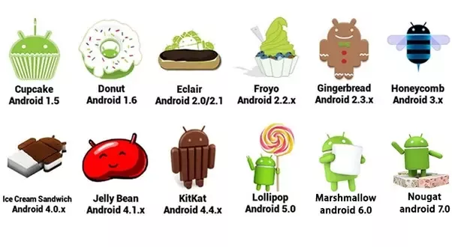
Name of Android Versions

Slide 4

Android Version 1
The initial version of Android was released on September 23, 2008, known as Android 1.0. There were many loopholes in this alpha version including the necessity of physical keyboards or hardware buttons. It has an Android API (application program interface) level

Slide 5

Android Version 2
Android 2.0 is a major platform release deployable to Android-powered handsets starting in November 2009. The release includes new features for users and developers, as well as changes in the Android framework API. For developers, the Android 2.0 platform is available as a downloadable component for the Android SDK.

Slide 6

Android Version 3
Android 3.0 came into the world as a tablet-only release to accompany the launch of the Motorola Xoom, and through the subsequent 3.1 and 3.2 updates, it remained a tablet-exclusive (and closed-source) entity.

Slide 7

Android Version 4
Unveiled on October 19, 2011, Android 4.0 builds upon the significant changes made by the tablet-only release Android Honeycomb, in an effort to create a unified platform for both smartphones and tablets. The first phone with Android Ice Cream Sandwich was Samsung Galaxy Nexus.

Slide 8

Android Version 5
Android 5.0 Lollipop—the largest and most ambitious release for Android yet! This release is packed with new features for users and thousands of new APIs for developers. It extends Android even further, from phones, tablets, and wearables, to TVs and cars.

Slide 9

Android Version 6
Android Marshmallow is the sixth major version of the Android operating system developed by Google, being the successor to Android Lollipop. It was announced at Google I/O on May 28, 2015, and released the same day as a beta, before being officially released on September 29, 2015.

Slide 10

Android Version 7
Android Nougat is the seventh major version and 14th original version of the Android operating system. First released as an alpha test version on March 9, 2016, it was officially released on August 22, 2016, with Nexus devices being the first to receive the update.

Slide 11

Android Version 8
Android Oreo is the eighth major release and the 15th version of the Android mobile operating system. It was initially unveiled as an alpha quality developer preview in March 2017 and later made available to the public, on August 21, 2017.

Slide 12

Android Version 9
Android Pie (codenamed Android P during development), also known as Android 9 (API 28) is the ninth major release and the 16th version of the Android mobile operating system.

Slide 13

Android Version 10
Android 10 (codenamed Android Q during development) is the tenth major release and the 17th version of the Android mobile operating system. It was first released as a developer preview on March 13, 2019, and was released publicly on September 3, 2019. Android 10.

Slide 14
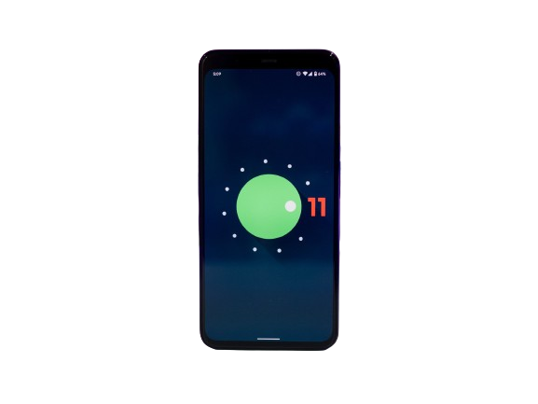
Android Version 11
Android 11 is the eleventh major release and 18th version of Android, the mobile operating system developed by the Open Handset Alliance led by Google. It was released on September 8, 2020.

Slide 15

Android Version 12
Android 12 is the twelfth major release and 19th version of Android, the mobile operating system developed by the Open Handset Alliance led by Google. The first beta was released on May 18, 2021.

Slide 16
Thank you

